Slide 1

GENOMIC PROJECT V2.0
BRCA1: GUARDIAN OF THE GENOME
Exploration of DNA Repair Mechanics & Clinical Risk Simulation
PYTHON CORE • PLOTLY • 3DMOL.JS • STREAMLIT UI

Slide 2
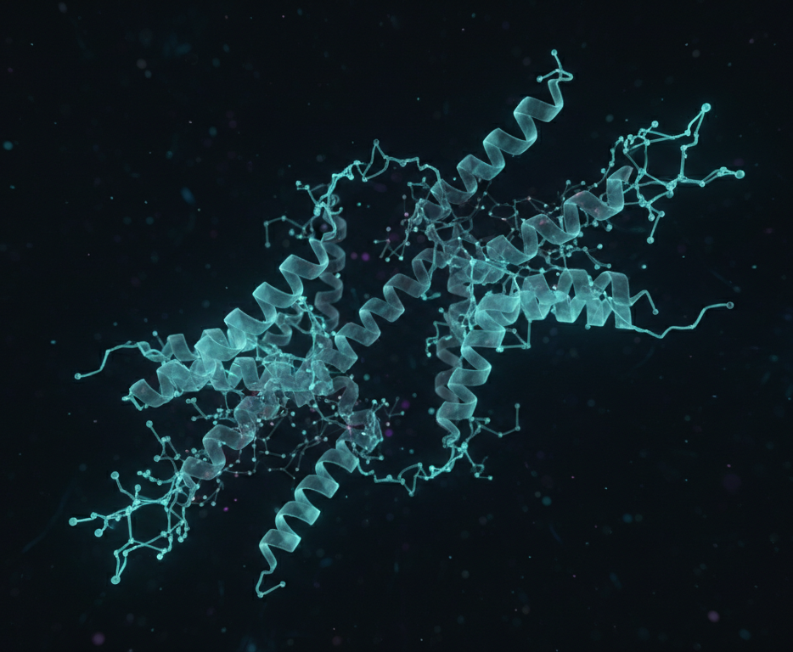
01 / BIOLOGICAL CONTEXT
The Cell's Chief Mechanic
BRCA1 is a Tumor Suppressor Gene that monitors genetic integrity.
It initiates Homologous Recombination (HR) to repair double-strand DNA breaks caused by stress, radiation, or aging.
"A non-functional BRCA1 protein essentially leaves the genome vulnerable to catastrophic mutation accumulation."
02

Slide 3
02 / CLINICAL STATISTICS
Statistical Risk Profile
72%
Lifetime Breast Cancer Risk
Lifetime Multiplier Risk
Compared to only 12% in the general population.
Secondary Risk Profile
Ovarian cancer risk: 1.3% → 44%
03

Slide 4
03 / GENETIC VARIANTS
Mutation Taxonomy
FRAMESHIFT
MISSENSE
INSERTION
185delAG
C61G
5382insC
Deletions that shift the reading frame, rendering protein synthesis terminal.
Single nucleotide "typo" swapping a critical amino acid in the RING domain.
Insertion of a cytosine base causing a downstream frameshift error.
AGATC[--]TCA
TGCA[G]ATTG
CGGT[C]CGTA
04

Slide 5
04 / DATA WAREHOUSE
Variant Baseline Registry
Mutation | Clinical Significance | Risk Exposure | Discovery
185delAG | Pathogenic | 0.98 | 1995
5382insC | Pathogenic | 0.94 | 1996
C61G | Likely Pathogenic | 0.88 | 1998
T1700A | VUS | 0.72 | 2005
R1699Q | Pathogenic | 0.82 | 2001
05

Slide 6
05 / CELLULAR DYNAMICS
Functional Impact Pathways
Path A: Integrity
Path B: Malignancy
Normal repair preserves the genome.
Mutation accumulation triggers tumor growth.
✓ DNA DAMAGE DETECTED
✓ BRCA1 RECRUITMENT
✓ HR REPAIR SUCCESSFUL
⚠ REPAIR MECHANISM FAIL
⚠ MUTATION ACCUMULATION
⚠ UNCONTROLLED DIVISION
GENOMIC STABILITY
ONCOGENESIS
06

Slide 7
06 / SOLUTION ARCHITECTURE
BRCA1 Insight Platform
TOTAL VARIANTS
AVG PATH RISK
OVERVIEW ANALYSIS RESOURCES
05
0.87
Clinical Intelligence Interface
Building an ecosystem that bridges the gap between raw genomic data and clinical actionability.
DASHBOARD MOCKUP
DYNAMIC SCALING
ZERO LATENCY
07

Slide 8
07 / INTERACTIVE ANALYSIS
3D Molecular Structural View
PDB: 1JNX
Direct browser-side rendering of the BRCT domain. Researchers can verify structural stability when missense mutations occur at binding interfaces.
3D Viewer (PDB: 1JNX)
✓ ATOM MAPPING ACTIVE
✓ RIBBON SPECTRUM RENDERING
✓ CLIENT-SIDE RAYCASTING
08

Slide 9
08 / PREDICTIVE MODELING
Patient Risk Simulation
Heuristic Algorithm
Baseline Mutation Risk
0.98
Delta-Shift Analysis
Age Factor (45yr+)
+5%
Evaluating how lifestyle modifiers either escalate or mitigate the genetic predisposition.
Environment Multiplier
x1.20
Adjusted Patient Risk
0.999
09

Slide 10
09 / ADVANCED ANALYTICS
Multi-Dimensional Risk Radar
Comparison of all five clinical variants across one unified risk landscape.
This allows for instant identification of Risk Outliers and VUS Clusters within the cohort.
10

Slide 11
10 / TECHNICAL STACK
System Architecture
LINUX
PYTHON
ST-APP
BIO-UI
Engineered for Atomic Efficiency via caching and client-side visualization libraries.
11

Slide 12
11 / GLOBAL EPIDEMIOLOGY
Allele Frequency Distribution
Founder Mutations
Variants like 185delAG show significantly higher prevalence in Ashkenazi Jewish populations, illustrating the importance of ethnic-specific risk assessment.
Data Source: ClinVar + Ensemble Variant Databases
12

Slide 13
12 / PROJECT IMPACT
About the Developer
Built by a student aiming to understand how Bio-Computational Tools can change our approach to hereditary cancer.
Focus on bridging biology and software engineering.
Curiosity Driven Build
GITHUB: NAN0ADEL775-CELL
13

Slide 14
THE END.
Precision Medicine is the Future of Oncology.
Research Access Granted
14

